Slide 1
Advanced
Organic Chemistry
Chapter 2
Stereochemistry

Slide 2
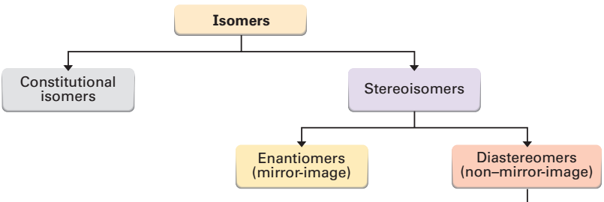



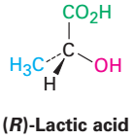
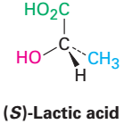

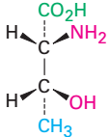
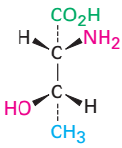


Isomers

Slide 3
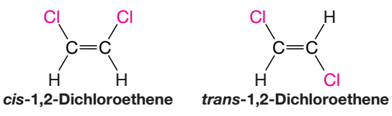
Cis-Trans Isomerism
Restricted rotation of groups joined by a double bond causes a new type of isomerism: cis-trans geometric isomerism.
cis–trans isomers are not constitutional isomers, because the connectivity of the atoms is the same in each isomer.
cis–trans isomers are actually diastereomers, because the two isomers differ only in the arrangement of their atoms in space and they are not mirror images of each other.

Slide 4
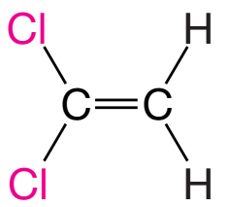
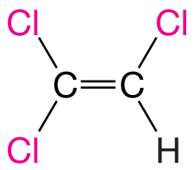
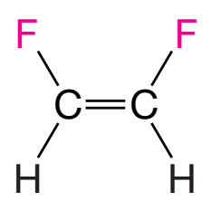
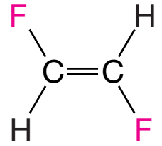


Cis-Trans Isomerism
No cis-trans isomerism
No cis-trans isomerism
cis–trans isomerism of this type is not possible if one carbon atom of the double bond bears two identical groups.

Slide 5
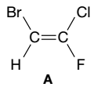
The (E)-(Z) System for Designing Alkene Diastereomers
If an alkene is trisubstituted or tetrasubstituted, the terms cis and trans are ambiguous or do not apply at all.
In the case of alkene A, it is impossible to decide whether A is cis or trans without additional rules:
A system that works in all cases is based on the priorities of groups in the Cahn–Ingold–Prelog convention .
This system, called the (E)–(Z) system, applies to alkene diastereomers of all types.

Slide 6
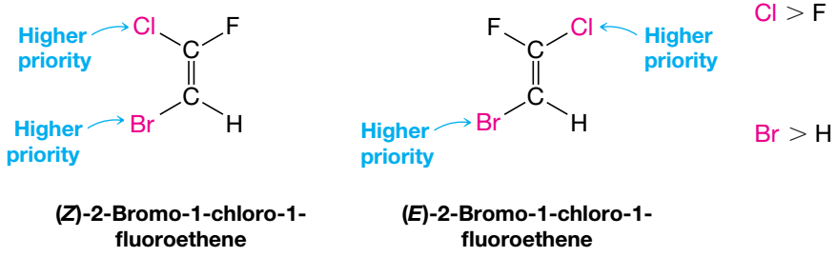
How to use (E)-(Z) System
Examine the two groups attached to one carbon atom of the double bond and decide which has higher Cahn–Ingold–Prelog priority.
Repeat that operation at the other carbon atom:
Priority setup and Cis trans setup: :vertically
If the two groups of higher priorityare on the same side of the double bond, the alkene is designated (Z).

Slide 7
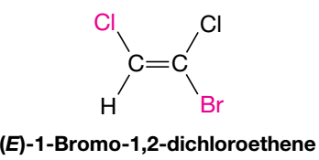
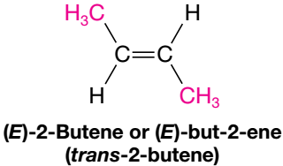


How to use (E)-(Z) System
If the two groups of higher priority are on opposite sides of the double bond, the alkene is designated (E) from the German word entgegen, meaning opposite.

Slide 8
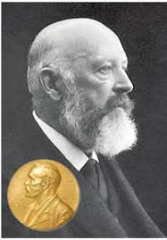
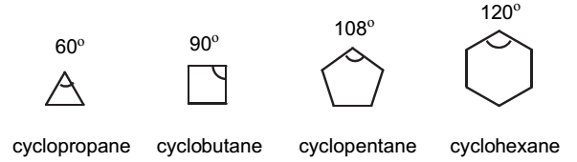
Conformation of Cycloalkane
The Shapes of Cycloalkanes: Planar or Non-Planar?
Adolf von Baeyer assumed that cycloalkanes including cyclohexane, were planar like benzene.
Since the ∠C-C-C bond angle of the sp³ hybridized carbon chain is 109°28′, cycloalkanes will suffer some strain if they are planar.
Adolf von Baeyer
Nobel laureate
(1905)

Slide 9
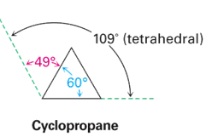
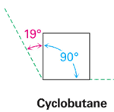
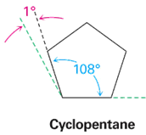
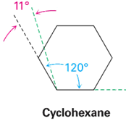
Cycloalkane: Planar or Non-Planar?
Adolf von Baeyer proposed that any deviation of bond angle from ideal bond angle value (109.5°) will produce a strain in molecule (Baeyer’s strain theory).
According to this theory, all cycloalkanes, except cyclopentane, become unstable because of this strain (Baeyer’s strain).
Baeyer assumed that the most stable cycloalkane is cyclopentane, and cyclohexane is the next.

Slide 10
Shape of Cycloalkane
According to this Baeyer’s strain theory higher the strain higher the instability : Higher strain produce increased reactivity and increases heat of combustion.
Size of the Ring | Heat of Combustion |  | Total Strain |  | Strain per CH₂
(n) | (kcal/ mol) | (kJ /mol) | (kcal/mol) | (kJ/mol) | (kcal/mol) | (kJ/ mol)
3 | 499.83 | 2091.3 | 27.5 | 115.1 | 9.17 | 38.4
4 | 656.07 | 2745.0 | 26.3 | 110.1 | 6.58 | 27.5
5 | 793.40 | 3319.6 | 6.2 | 26.0 | 1.24 | 5.19
6 | 944.77 | 3952.9 | 0.1 | 0.5 | 0.02 | 0.09
7 | 1108.3 | 4637.3 | 6.2 | 26.2 | 0.89 | 3.74
8 | 1269.2 | 5310.3 | 9.7 | 40.5 | 1.21 | 5.06

Slide 11
Shape of Cycloalkane
According to Baeyer, cyclopentane should have less angle strain than cyclohexane.
However, if we look at the table, we can see that the heat of combustion per CH₂ group is less for cyclohexane than for cyclopentane.
Cyclohexane has less strain than cyclopentane.
Size of the Ring | Heat of Combustion |  |  | Total Strain | Strain per CH₂
(n) | (kcal/ mol) | (kJ/ mol) | per CH₂ (kJ/ mol) | (kJ/ mol) | (kcal/ mol) | (kJ/ mol)
5 | 793.40 | 3319.6 | 663.8 | 26.0 | 1.24 | 5.19
6 | 944.77 | 3952.9 | 658.6 | 0.5 | 0.02 | 0.09

Slide 12
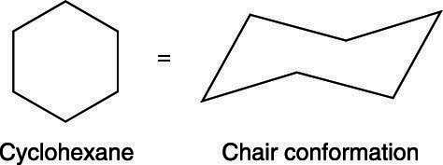
Shape of Cycloalkane
According to Baeyer, the relative order of stability for some common cycloalkanes is as follows:
Cyclopentane > Cyclohexane > Cyclobutane > Cyclopropane
Actual observed order of stability for these cycloalkanes is as follows:
Cyclohexane > Cyclopentane > Cyclobutane > Cyclopropane
Since the cyclohexane ring is virtually strain free, it does not have a planar structure as assumed by Baeyer.
Rather, the cyclohexane ring is puckered (chair or boat shaped) to eliminate possible angle strain.

Slide 13
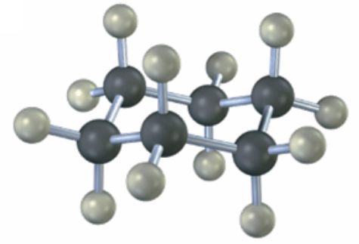
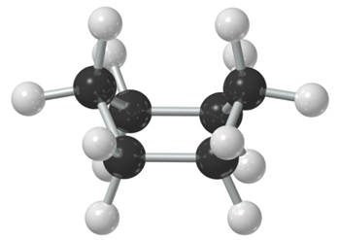
Conformations of Cyclohexane
Chair and boat conformations – which one is more stable?
Chair Conformation
of Cyclohexane
Boat Conformation
of Cyclohexane

Slide 14
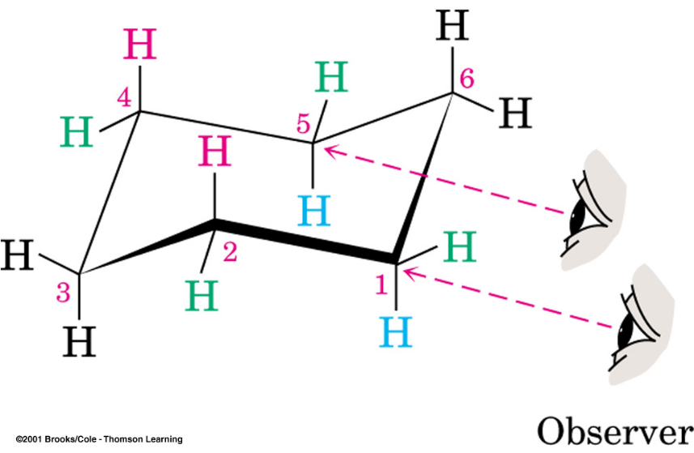
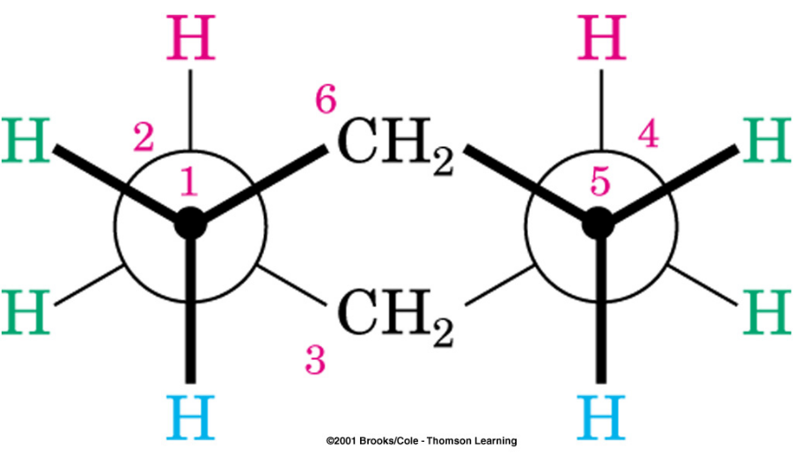
Chair Conformation of Cyclohexane
The chair conformation of cyclohexane is free of strain.
Chair is the most stable conformation of cyclohexane
All of the bonds are staggered and the bond angles at carbon are close to tetrahedral.
Chair Conformation
of Cyclohexane
Newman Projection of
Chair Conformer

Slide 15
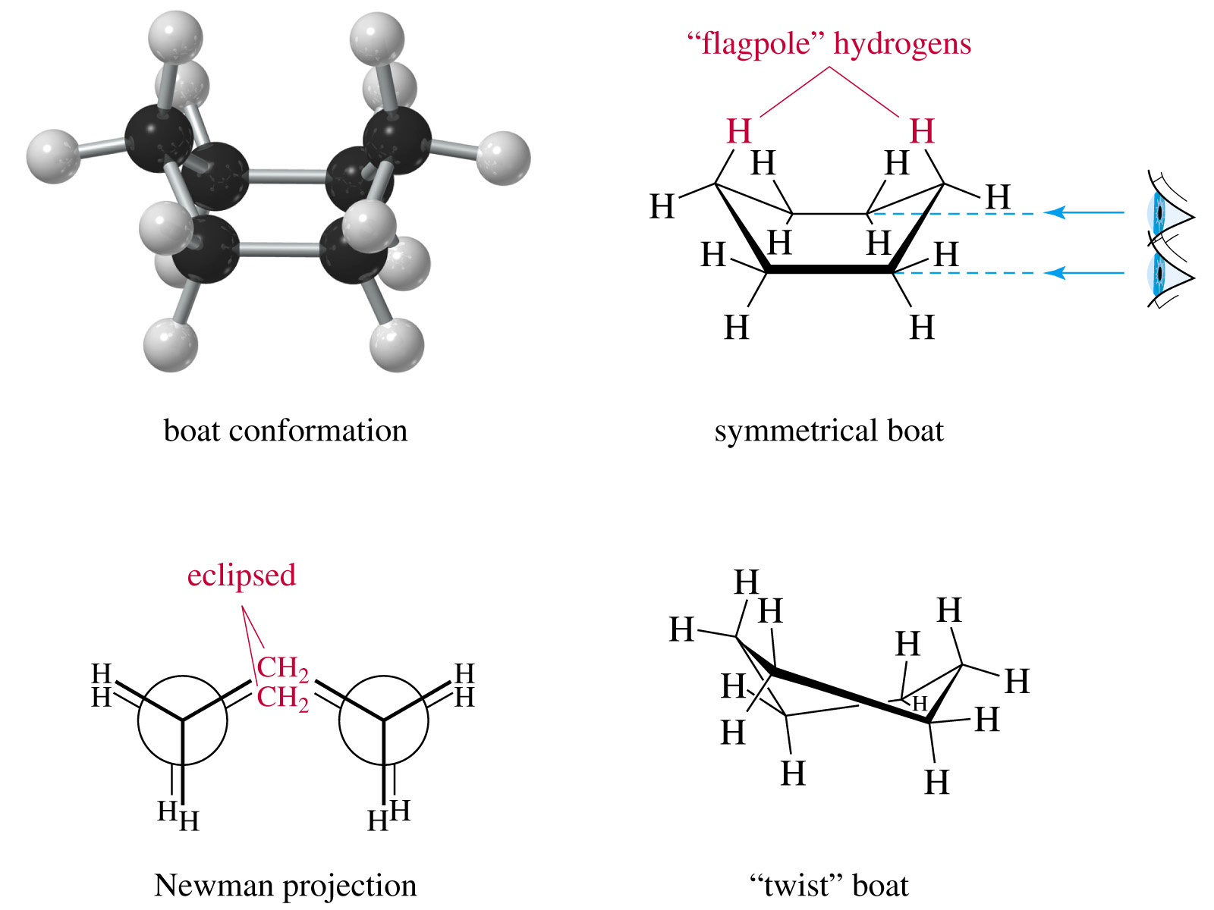
Boat Conformation of Cyclohexane

Slide 16
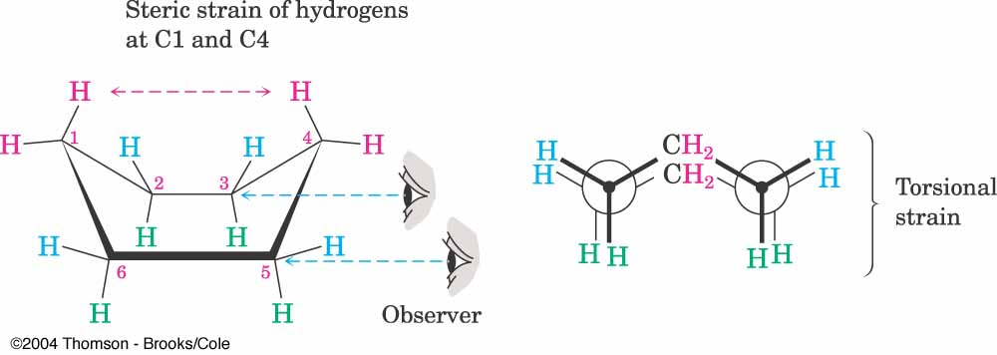
Boat Conformation of Cyclohexane
Boat conformation is less stable than the chair.
All of the bond angles are close to tetrahedral but close contact between flagpole hydrogens causes strain in the boat.
No angle strain, but a large number of eclipsing interactions (Torsional strain)

Slide 17
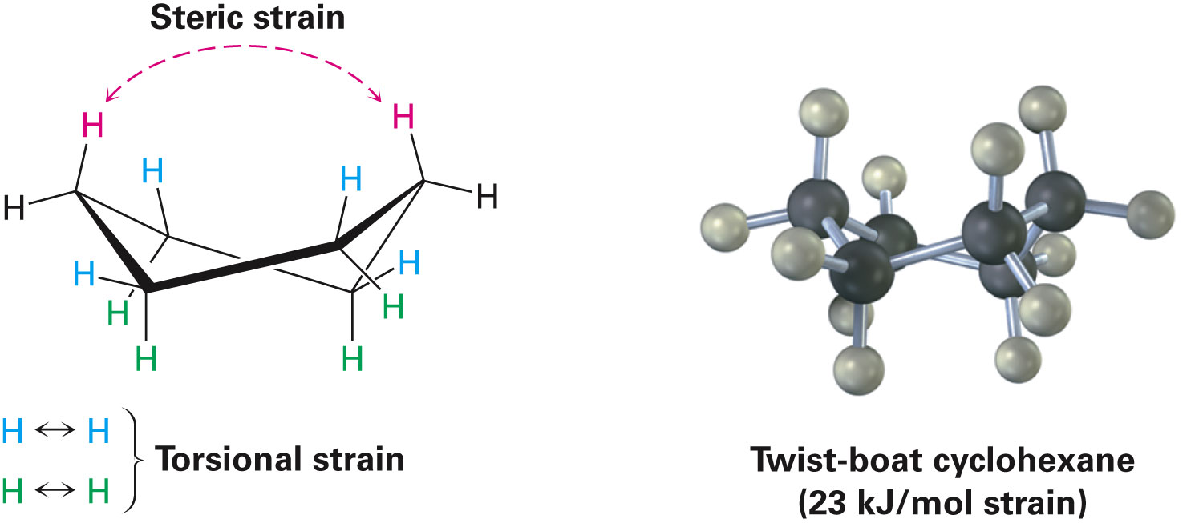
Twist-Boat Conformation of Cyclohexane
Twist-boat conformation of cyclohexane that is somewhat more stable than a pure boat conformation (1,4 distance larger) .

Slide 18
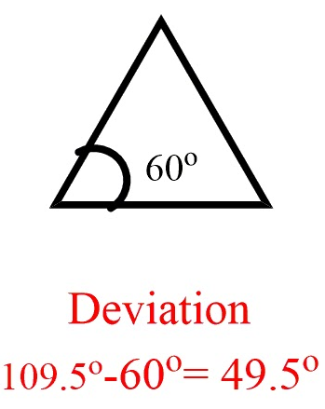
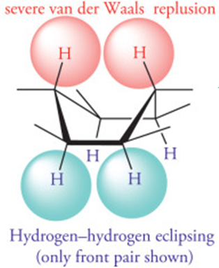
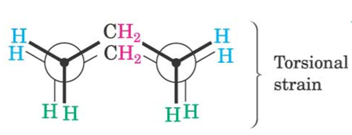
Types of Strain
Torsional strain (Pitzer strain) : Strain that results from eclipsing of bonds between neighbouring atoms. (measure of the dihedral angle)
Steric strain or Van der Waals strain : Strain that results due to repulsive interactions when atoms approach each other too closely.
Angle strain : Strain results from distortion of bond angles from normal values, for a tetrahedron 109.5º.
Angle strain : 24°44′

Slide 19
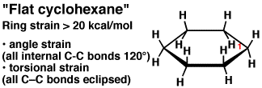
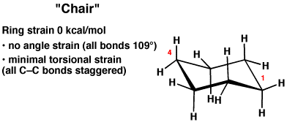
Conformations of Cyclohexane
In solution, the flat conformation of cyclohexane is generally of too high an energy to be observed.
Since it lacks ring strain and is of lowest energy, the chair conformation is the dominant conformation in solution.

Slide 20
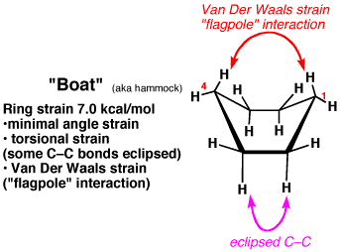
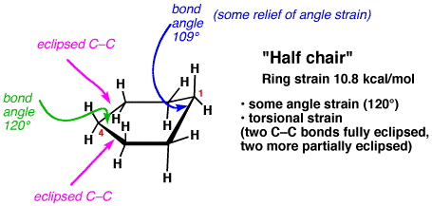
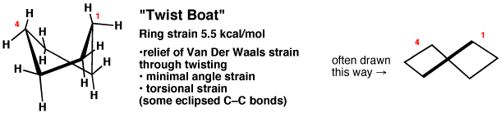
Conformations of Cyclohexane

Slide 21




Conformations of Cyclohexane

Slide 22
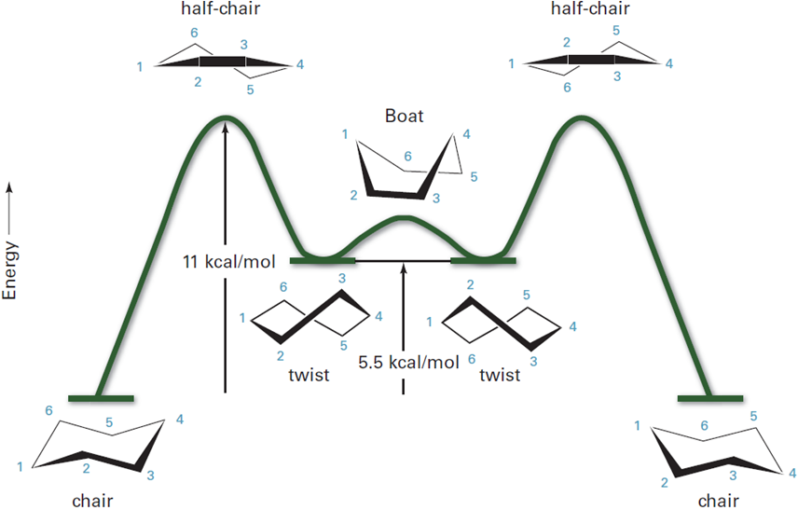
Potential Energy of Cyclohexane
as a function of conformation

Slide 23
Advanced
Organic Chemistry
Chapter 2
Stereochemistry

Slide 24
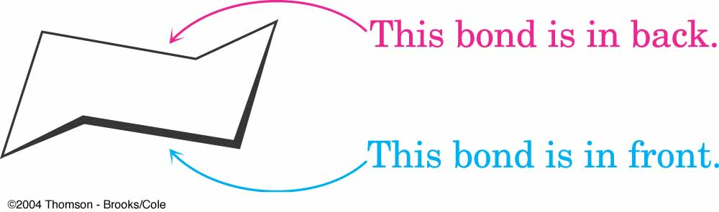
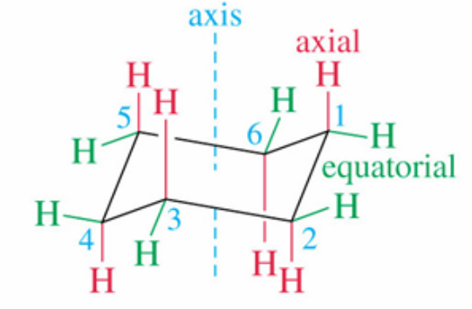
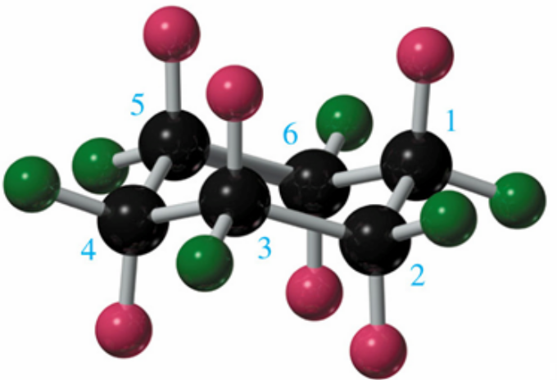
Cyclohexane Chair Conformation
ring equator

Slide 25
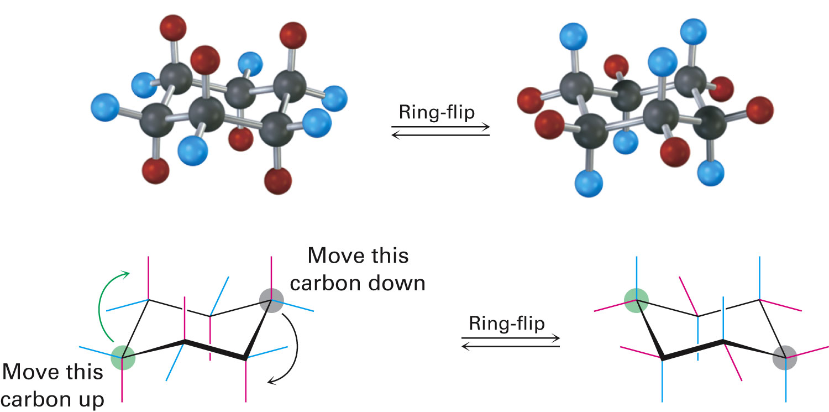
Conformational Mobility of Cyclohexane
Ring-flip: Interconversion of chair conformations, resulting in the rapid exchange of axial and equatorial positions

Slide 26
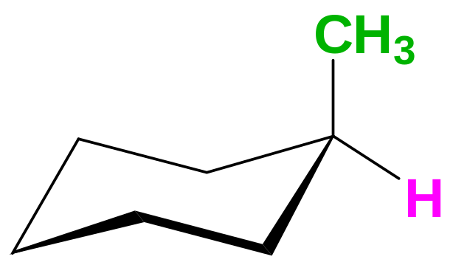
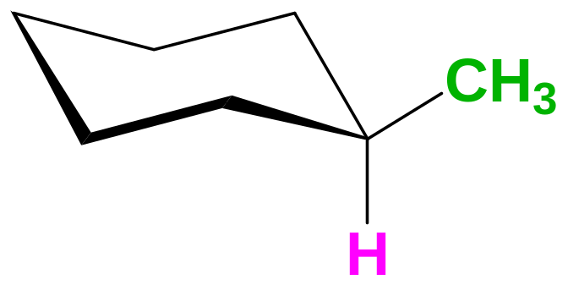
Monosubstituted Cyclohexane
(Methylcyclohexane)
When there is one substituent on the cyclohexane ring, the two chair conformations are no longer equivalent.
CH3 in the equatorial position is more stable because1,3-diaxial interaction occurs in axial postion.
Ring-flip
Why does the equatorial chair dominate the equilibrium?

Slide 27
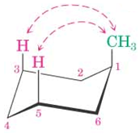
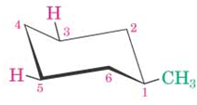

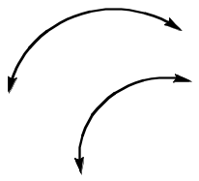
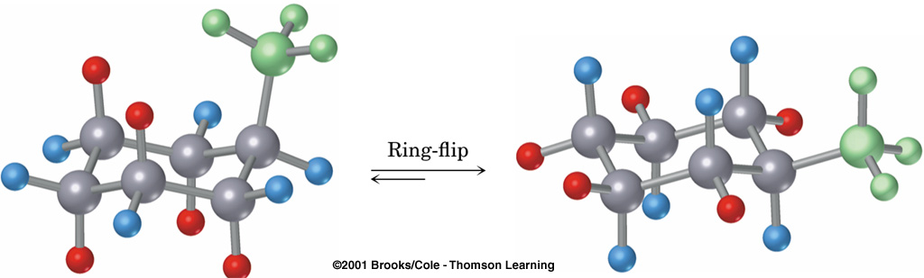
Methylcyclohexane
Equatorial Conformation is Preferred
1,3-Diaxial interaction

Slide 28
Methylcyclohexane
5%
95%
Chair-chair interconversion occurs, but at any instant 95% of the molecules have their methyl group equatorial.
An axial methyl group is more crowded than an equatorial one.
Hydrogen atoms closer than 2.4 Ǻ will cause steric strain.
This is called a "1,3-diaxial repulsion" a type of van der Waals strain or steric strain.

Slide 29
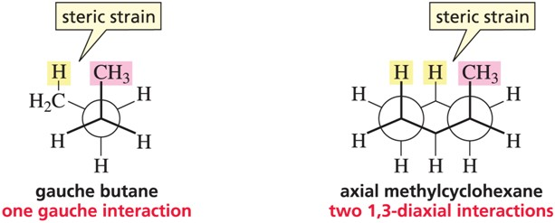
Methylcyclohexane
Gauche is 0.9 kcal/mol less stable than anti.
Axial is 1.8 kcal/mol less stable than equatorial

Slide 30
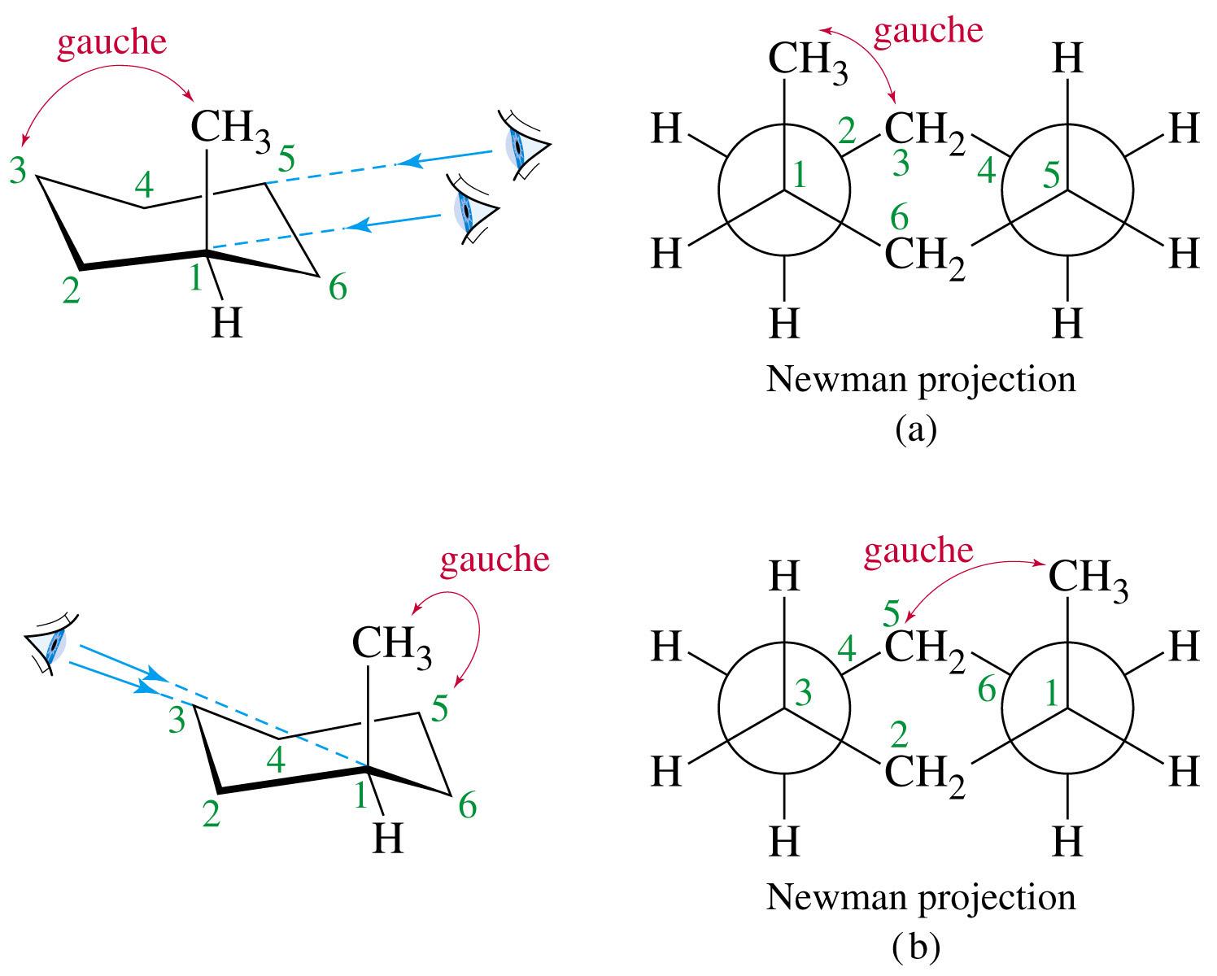
Axial methyl group is Gauche to C₃ in the ring
Methylcyclohexane

Slide 31
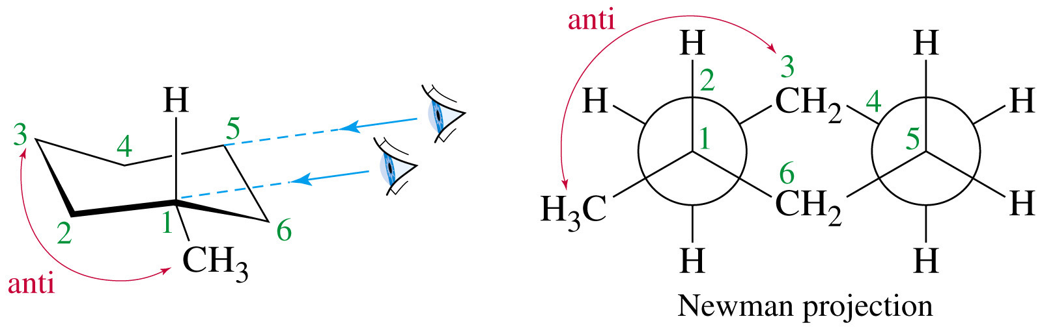

Equatorial Methyl Group is Anti to C₃ in the ring
Equatorial
Axial
Methylcyclohexane

Slide 32


The Bigger The Group, The Bigger The Strain
40%
60%
3%
97%

Slide 33

Monosubstituted Cyclohexane
tert-Butyl Group Is Very Bulky
As an “anchor”.
Lock the molecule in this conformation
Less than 0.01%
(serious 1,3-diaxial repulsions involving tert-butyl group)
Greater than 99.99%
(Decreased
van der Waals strain)
The bulky groups like isopropyl, phenyl and t-butyl are so large that these will not tolerate the conformational flip into an axial orientation.

Slide 34



cis-1,2-Dimethylcyclohexane
Two equivalent conformations; each has one axial methyl group and one equatorial methyl group.

Slide 35



trans-1,2-Dimethylcyclohexane
Two conformations are not equivalent; the most stable conformation has both methyl groups equatorial.

Slide 36

cis-1,2-Dimethylcyclohexane

Slide 37

trans-1,2-Dimethylcyclohexane

Slide 38



trans-1,3-Dimethylcyclohexane
Two equivalent conformations; each has one axial methyl group and one equatorial methyl group.

Slide 39



cis-1,3-Dimethylcyclohexane
Two conformations are not equivalent; the most stable conformation has both methyl groups equatorial.

Slide 40


cis-1,3-Dimethylcyclohexane

Slide 41



cis-1,4-Disubstituted Cyclohexanes
Two equivalent conformations; each has one axial methyl group and one equatorial methyl group.

Slide 42



trans-1,4-Disubstituted Cyclohexanes
Two conformations are not equivalent; the most stable conformation has both methyl groups equatorial.

Slide 43


1,4-Disubstituted Cyclohexanes

Slide 44


Conformations of cis-1-Chloro-4-t-butylcyclohexane

Slide 45

Heats of Combustion of Isomeric Dimethylcyclohexane

Slide 46


Axial and Equatorial Relationships in cis- and trans-Disubstituted Cyclohexane
(a,a)
(e,e)

Slide 47



Conformation and Conformer
Two groups bonded by only a single bond can undergo rotation about that bond with respect to each other.
Rotation about C‒C single bonds allows a compound to adopt a variety of possible three-dimensional shapes, called conformations.
A conformer is an isomer of a molecule that differs from another isomer by the rotation of a single bond in the molecule. A conformer is also known as a conformational isomer.
rotate
Conformations of Ethane

Slide 48

Newman Projection
In drawing conformations, we often use Newman projections, a way of drawing a molecule looking straight down the bond connecting two carbon atoms.

Slide 49



Staggered Conformations of Ethane
The staggered conformation is the most stable, because the maximum possible separation of the electron pairs in the C−H bonds occurs here.
The staggered conformation also possesses hyperconjugation that involves a favorable interaction between an occupied, bonding MO and an unoccupied, antibonding MO.

Slide 50



Eclipsed Conformations of Ethane
The eclipsed conformation is the least stable conformation, because electron clouds from the C−H bonds are closer and repel one another.

Slide 51

What is Conformational Analysis?
An analysis of the energy changes that occur as a molecule undergoes rotations about single bonds is called a conformational analysis.

Slide 52

Conformational Analysis of Ethane
(Potential energy vs Rotation)
The energy difference between the staggered & eclipsed conformations is ∼ 12 kJ mol⁻¹. This small barrier to rotation is called the torsional barrier of the single bond.
At any given moment, unless the temperature is extremely low (−250 °C), most ethane molecules will have enough energy to undergo bond rotation from one conformation to another.

Slide 53

Conformational Analysis of Ethane
(Potential energy vs Dihedral angle)

Slide 54












Conformational Analysis of Butane
Six important conformers of butane:

Slide 55
Conformational Analysis of Butane
The anti conformation (I) does not have torsional strain from steric hindrance because the groups are staggered and the methyl groups are far apart. The anti conformation is the most stable.
The methyl groups in the gauche conformations III and V are so close that they repel each other. This repulsion causes the gauche conformations to have ~ 3.8 kJ mol⁻¹ more energy than the anti conformation.

Slide 56
Conformational Analysis of Butane
Eclipsed conformations II and VI have repulsive dispersion forces arising from the eclipsed methyl groups and hydrogen atoms.
Eclipsed conformation IV has the greatest energy of all because of the added large repulsive dispersion forces between the eclipsed methyl groups as compared to II and VI

Slide 57

Energy Changes that arise from Rotation about the C2-C3 bond

Slide 58
Practice Problem
Draw the all possible conformational stereoisomers that result from the rotation about the C2‒C3 bond of n-butane and answer the following questions:
How many of the carbon-carbon bonds in the compound have the staggered conformations and how many of them are equally stable?
How many of the carbon-carbon bonds in the compound have the eclipsed conformations that are equally stable?
Draw a potential energy diagram for the rotation of the C2‒C3 bond of n-pentane through 360°, starting with the least stable conformer.

Slide 59






Conformational Analysis of n-Pentane

Slide 60


Slide 61

Absolute Configuration
Absolute configuration refers to the spatial arrangement of atoms within a chiral molecule and its resultant stereochemical description.
The absolute configuration of a chirality center is its (R ) or (S) designation, which is based on the Cahn–Ingold–Prelog priority rules..

Slide 62

Relative Configuration
Relative configuration can be applied within the same molecule (such as cis- or trans-) or it can be applied to intermolecularly (i.e. a pair of enantiomers have opposite configurations).
Relative configuration in stereochemistry is the arrangement of atoms or group of atoms that is described relative to other atoms or group of atoms in the molecule.
The arrangement of atoms in an optically active molecule, based on chemical interconversion from or to a known compound, is also a relative configuration.

Slide 63

Relative Configuration
Before 1951 only relative configurations of chiral molecules were known.
No one prior to that time had been able to
determine the absolute configuration of an optically active compound.
The configurations of chiral molecules were related to each other through reactions of known stereochemistry.
The chirality centers in I and II have the same relative configuration, because they share same three groups and these groups with the central carbon can be superposed in a pyramidal arrangement.

Slide 64






Relative Configuration
Prior to any known absolute configurations, attempts were made to relate all configurations to a single compound that had been chosen arbitrarily to be the standard which was glyceraldehyde.
In 1888, the two enantiomers of glyceraldehyde [(+)- and (–)] had been isolated and characterized.
Before 1951 no one was sure, however, whether (+)-glyceraldehyde was (R) or (S)!

Slide 65


Relative Configuration : Emil Fischer’s Big Guess!
Since there’s no simple correlation between the configuration of a chiral centre and optical rotation, Emil Fischer chose to guess!
Emil Fischer arbitrarily to assign the (R) configuration to the (+)-enantiomer of glyceraldehyde:
Then, configurations of other molecules were related to one glyceraldehyde enantiomer or the other through reactions of known stereochemistry.

Slide 66









Relative Configuration
The configuration of (-)-lactic acid can be related to (+)-glyceraldehyde through the following sequence of reactions in which no bond to the chirality center is broken:
Because none of the bonds to the chirality center has been broken during the sequence, its original (R)-configuration is retained.

Slide 67

Relative Configuration
A reaction is said to proceed with retention of configuration at a chirality center if no bonds to the chirality center are broken.
The following reaction occurs with retention of configuration and that also retains the same R,S designation in the product as in the reactant, because none of the bonds at the chirality center are broken.

Slide 68
Absolute Configuration – How to Determine it?
Before 1951 No One had been able to determine the absolute configuration of an optically active compound.
The usual methods for determining the structure of molecules, such as ordinary X-ray diffraction, do not distinguish between enanriomers.
It was only in 1951 that the first experimental determination of the absolute configuration of any chiral molecule was achieved by using anomalous scattering in single crystal X-ray analysis.

Slide 69

Determination of Absolute Configuration
In 1951 J. M. Bijvoet, the director of the van’t Hoff Laboratory of the University of Utrecht in the Netherlands, first determined the absolute configuration of (2R,3R)-(+)-tartaric acid by using the anomalous scattering effect of heavy atoms in X-ray diffraction experiments.
Bijvoet and coworkers were able to study a single crystal of sodium rubidium (+)-tartrate tetrahydrate with a type of X-ray diffraction
which involved the use of X-rays of a wavelength that just excites a single heavy atom — in Bijvoet's case, rubidium—to extract phase information.

Slide 70







crystal
The absolute structure of a chiral crystal is determined from the intensity differences of pairs of diffraction spots (reflections) that are related by an inversion symmetry (the intensities are called I_{(hkl)} and I_{(-h-k-l-)}.
These reflections are known as Bijvoet pairs.

Slide 71



Determination of Absolute Configuration
Emil Fischer arbitrarily proposed that (+)-tartaric acid had the (R,R)-configuration (also L-configuration) relating to the configuration of glyceraldehyde.
Nearly 60 years later Bijvoet was able to
confirm conclusively that (+)-tartaric acid indeed had the (R,R)-absolute configuration!!!
This meant that the Fischer’s original arbitrary assignment of the configurations of (R)-(+)- and (S)-(‒)-glyceraldehyde was also correct!!!
What a Lucky Guess!
(R,R)-(+)-tartaric acid
L-tartaric acid

Slide 72


The First page of the famous 1951 Article of Bijvoet in Nature.

Slide 73


Determination of Absolute Configuration
Bijvoet’s pioneering work which uses anomalous scattering in single crystal X-ray analysis, introduced a system for the determination of absolute configuration of other chiral molecules.
A pertinent example of the original Bijvoet method is shown below where the absolute configuration of (‒)-2-(1-naphthyl)propane-1,2-diol was determined by anomalous X-ray crystallography of its (‒)-p-bromobenzoate derivative.

Slide 74
Methods for Determination of Absolute Configuration
The Bijvoet method is one of the most common methods of determining the absolute chirality of chiral compounds.
Limitations of the Bijvoet method:
the incorporation of heavy atoms is necessary
the compounds must then be crystallized.
Other methods for determination of absolute configuration:
CD (Circular Dichroism) Exciton Chirality Method
ab initio MO Calculation of CD or VCD.

Slide 75
Methods for Determination of Relative Configuration
There are many methods to determine relative configuration of chiral compounds:
X-ray structure analysis.
Chemical interconversion not affecting bonds to the chiral atom
Methods based on symmetry properties
Correlation via diastereomers
Chemical interconversion affecting bonds to a chiral atom in a “known” way.
¹H NMR Diamagnetic Anisotropy method

Slide 76







Chemical Interconversion not affecting Bonds to the Chiral Atom
If a compound Cabde can be converted to Cabdf without breaking bond to the chiral atom, then the configurations of both are unequivocally correlated.

Slide 77
Practice Problem
Define absolute and relative configuration. How can you determine absolute configuration?
Name the methods for the determination of relative configuration. Discuss the correlation method of chemical interconversion not affecting bonds to the asymmetric atom.
Show the determination of configuration of (+)-glyceraldehyde, (‒)-lactic acid, (+)-malic acid with respect to (+)-tartaric acid.

Slide 78





Problem Solution
When (R)-1-bromo-2-butanol reacts with KI in acetone the product is 1-iodo-2-butanol. Would the product be (R) or (S)?
Solution:
No bonds to the chirality center would be broken, so we can reason that the product would be the following:
The configuration of the product would still be (R) because replacing the bromine at C1 with an iodine atom does not change the relative priority of C1.

Slide 79
Dermination of Configuration of cis-trans isomers
The configuration cis-trans isomers can be determined by
(i) Physical Methods and (ii) Chemical Methods
Chemical Methods
Absolute method
Correlative method
Mechanistic method
(not affecting the configuration of double bond)

Slide 80

Absolute Methods for cis-trans Configuration Determination
Absolute methods rest on the fact that isomers in which functional or reactive groups are located cis to each other can sometimes be converted to cyclic lactones, anhydrides, amides, and so on, whereas the corresponding trans isomer cannot.
The maleic acid [cis-isomer] is converted, by gentle heating, into its cyclic anhydride.

Slide 81




Absolute Methods for cis-trans Configuration Determination
The trans-isomer, fumaric acid can not be converted into the cyclic anhydride at 100 °C.
A very high temperature is required to convert fumaric acid to the cyclic anhydride.
100 °C
H₂O

Slide 82


Correlative Methods for cis-trans Configuration Determination
Sometimes it is possible to determine the configurations of pairs of geometrical isomers by converting them into compounds of known configurations.
There are two trichlorocrotonic acids (I) and (II), one of which can be hydrolyzed to fumaric acid. Therefore this trichlorocrotonic acid must be the trans-isomer or E-isomer (I) and consequently the other isomer is the cis-isomer or Z-isomer (II).
E-isomer
E-isomer
Z-isomer

Slide 83


Correlative Methods for cis-trans Configuration Determination
Sometimes it is possible to determine the configurations of pairs of geometrical isomers by converting them into compounds of known configurations.
There are two trichlorocrotonic acids (I) and (II), one of which can be hydrolyzed to fumaric acid. Therefore this trichlorocrotonic acid must be the trans-isomer or E-isomer (I) and consequently the other isomer is the cis-isomer or Z-isomer (II).
E-isomer
E-isomer
Z-isomer

Slide 84




Correlative Methods for cis-trans Configuration Determination
E-isomer
Z-isomer
E-isomer
Z-isomer

Slide 85

Problem Solution
Q. Show configurational correlation of crotonic acid with fumaric acid
Solution:
E-isomer
E-isomer
E-isomer

Slide 86


Physical Methods for cis-trans Configuration Determination
Since cis-trans isomers are diastereomers, they will generally differ in physical properties.
Physical Methods
Dipole Moments
Melting Points
UV-Vis spectra
IR spectra
NMR spectra
cis-isomer
trans-isomer

Slide 87



Dipole Moments
The trans isomers have normally less dipole moments than their corresponding cis isomers
However, if one substitueent is electron-donating and the other electron-withdrawing, the bond moments are fully additive in trans-isomer. In this case, trans isomers have higher dipole moments than their corresponding cis isomers

Slide 88






Melting Points
In general, a trans isomer has greater symmetry than the corresponding cis isomer. Thus it packs more easily in the crystal lattice and hence has a higher melting point.
trans-Stilbene
trans-Stilbene
[crystal, m.p. 123 – 125 °C]
cis-Stilbene
[liquid, b.p. 82 – 84 °C

Slide 89




UV-Vis Spectra
Normally a trans isomer absorbs at higher wavelength than the corresponding cis isomer in UV-Vis spectroscopy.
cis-stilbene
λ_{max} = 280 nm
trans-stilbene
λ_{max} = 295 nm
Coplanarity is needed for the most effective overlap of the π - orbitals and increased ease of the π → π* transition. The cis-stilbene is forced into a nonplanar conformation due to steric effects.
trans-azobenzene
cis-azobenzene
λ_{max} = 320 nm
λ_{max} = 281 nm

Slide 90

HomeWork
Interconversion of cis-trans iosmers
Stereochemistry of Organic Compounds
by
Ernest L. Eliel
Samuel H. Wilen

